Slide 1
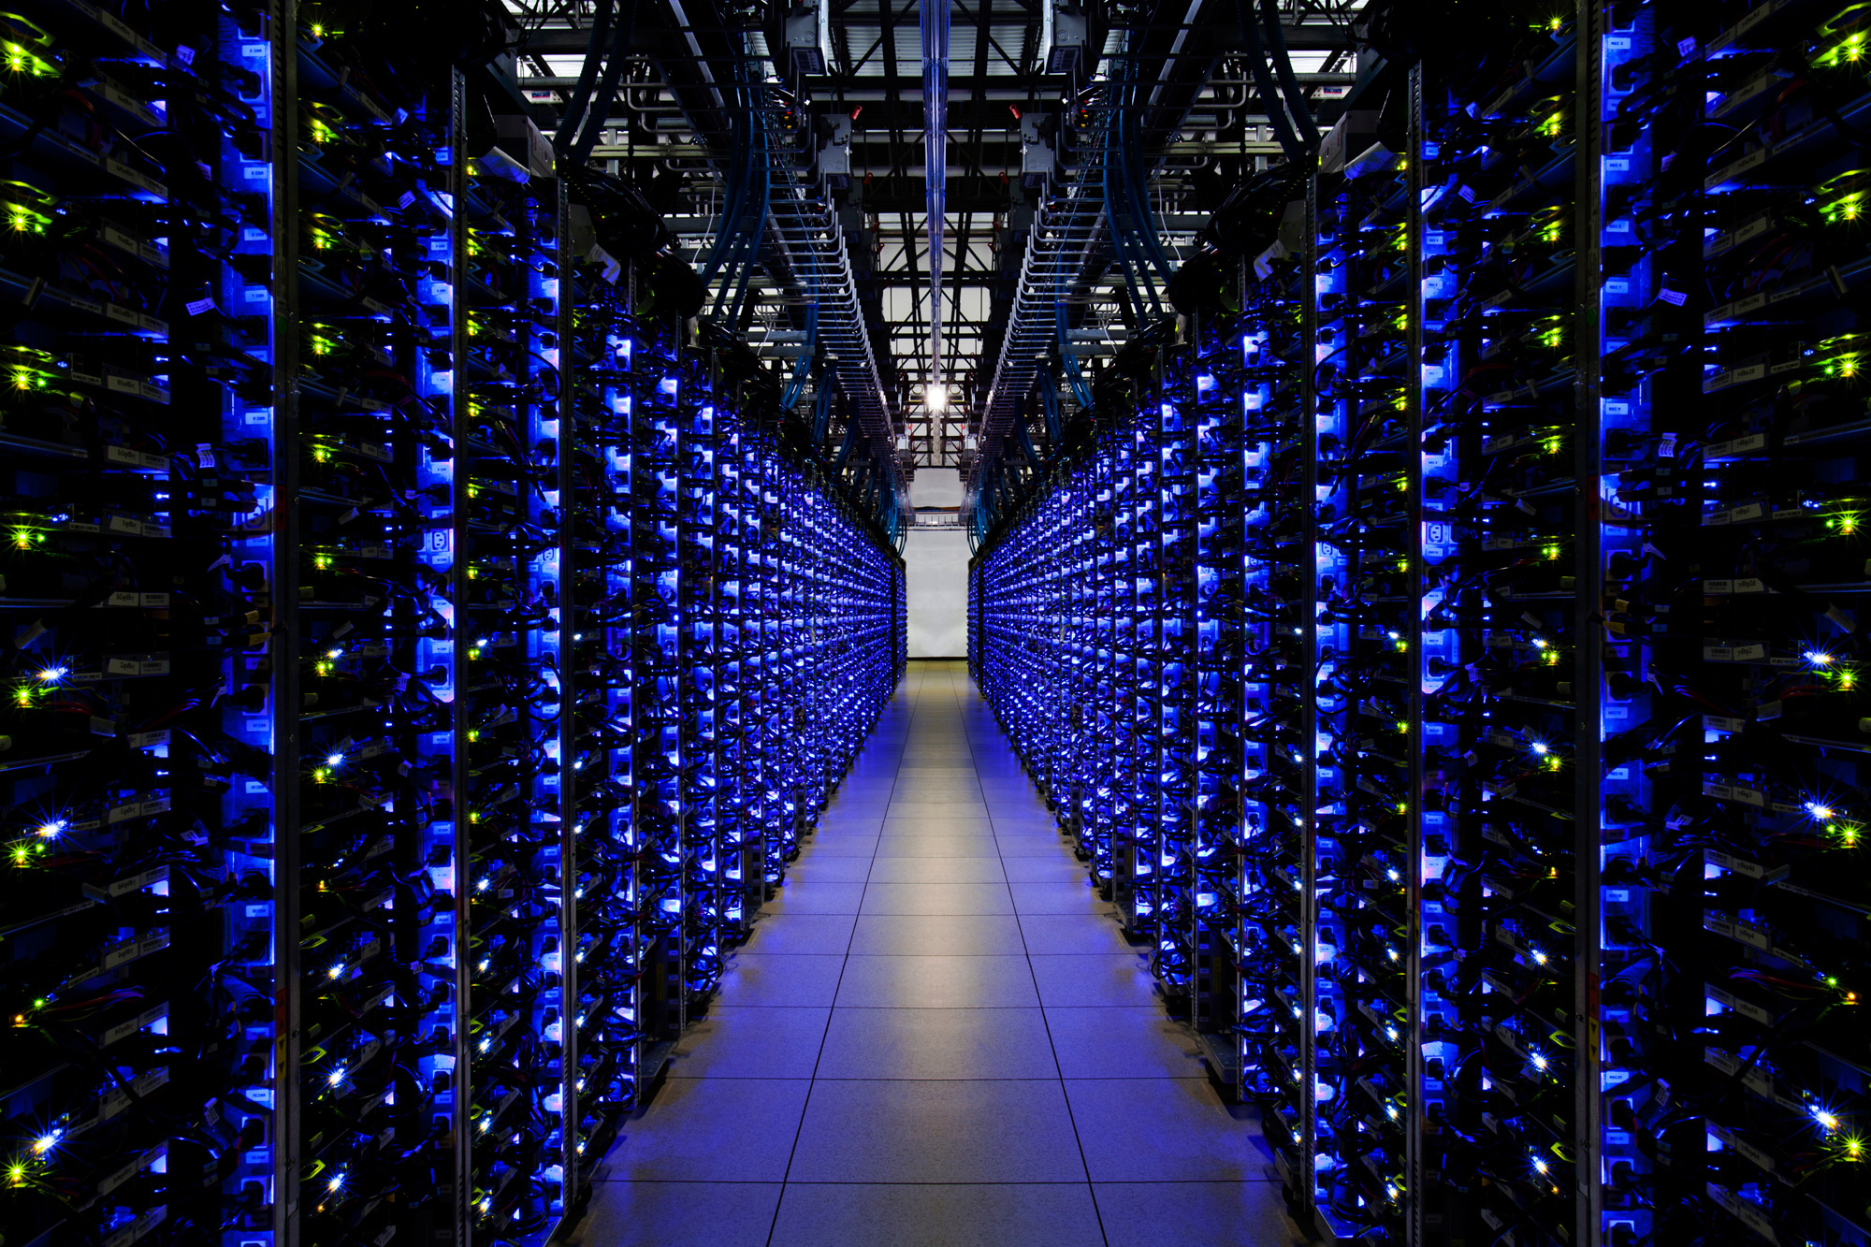
BNVirt : Bare Metal Network Virtualization

Slide 2

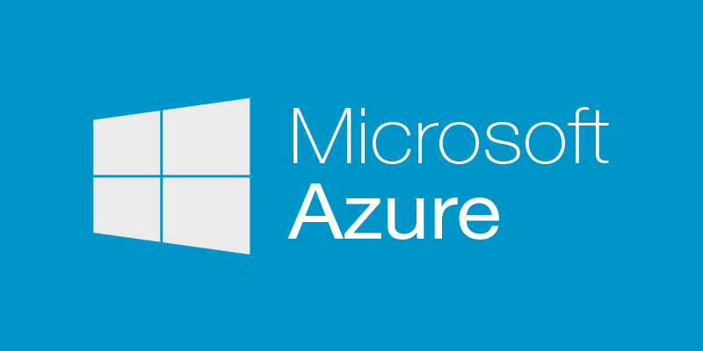












Slide 3
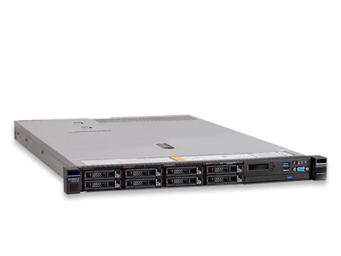




Virtual Machines vs Bare Metal
VM7
VM6
VM5
VM4
VM3
VM2
VM1
Vmware or QEMU

Slide 4
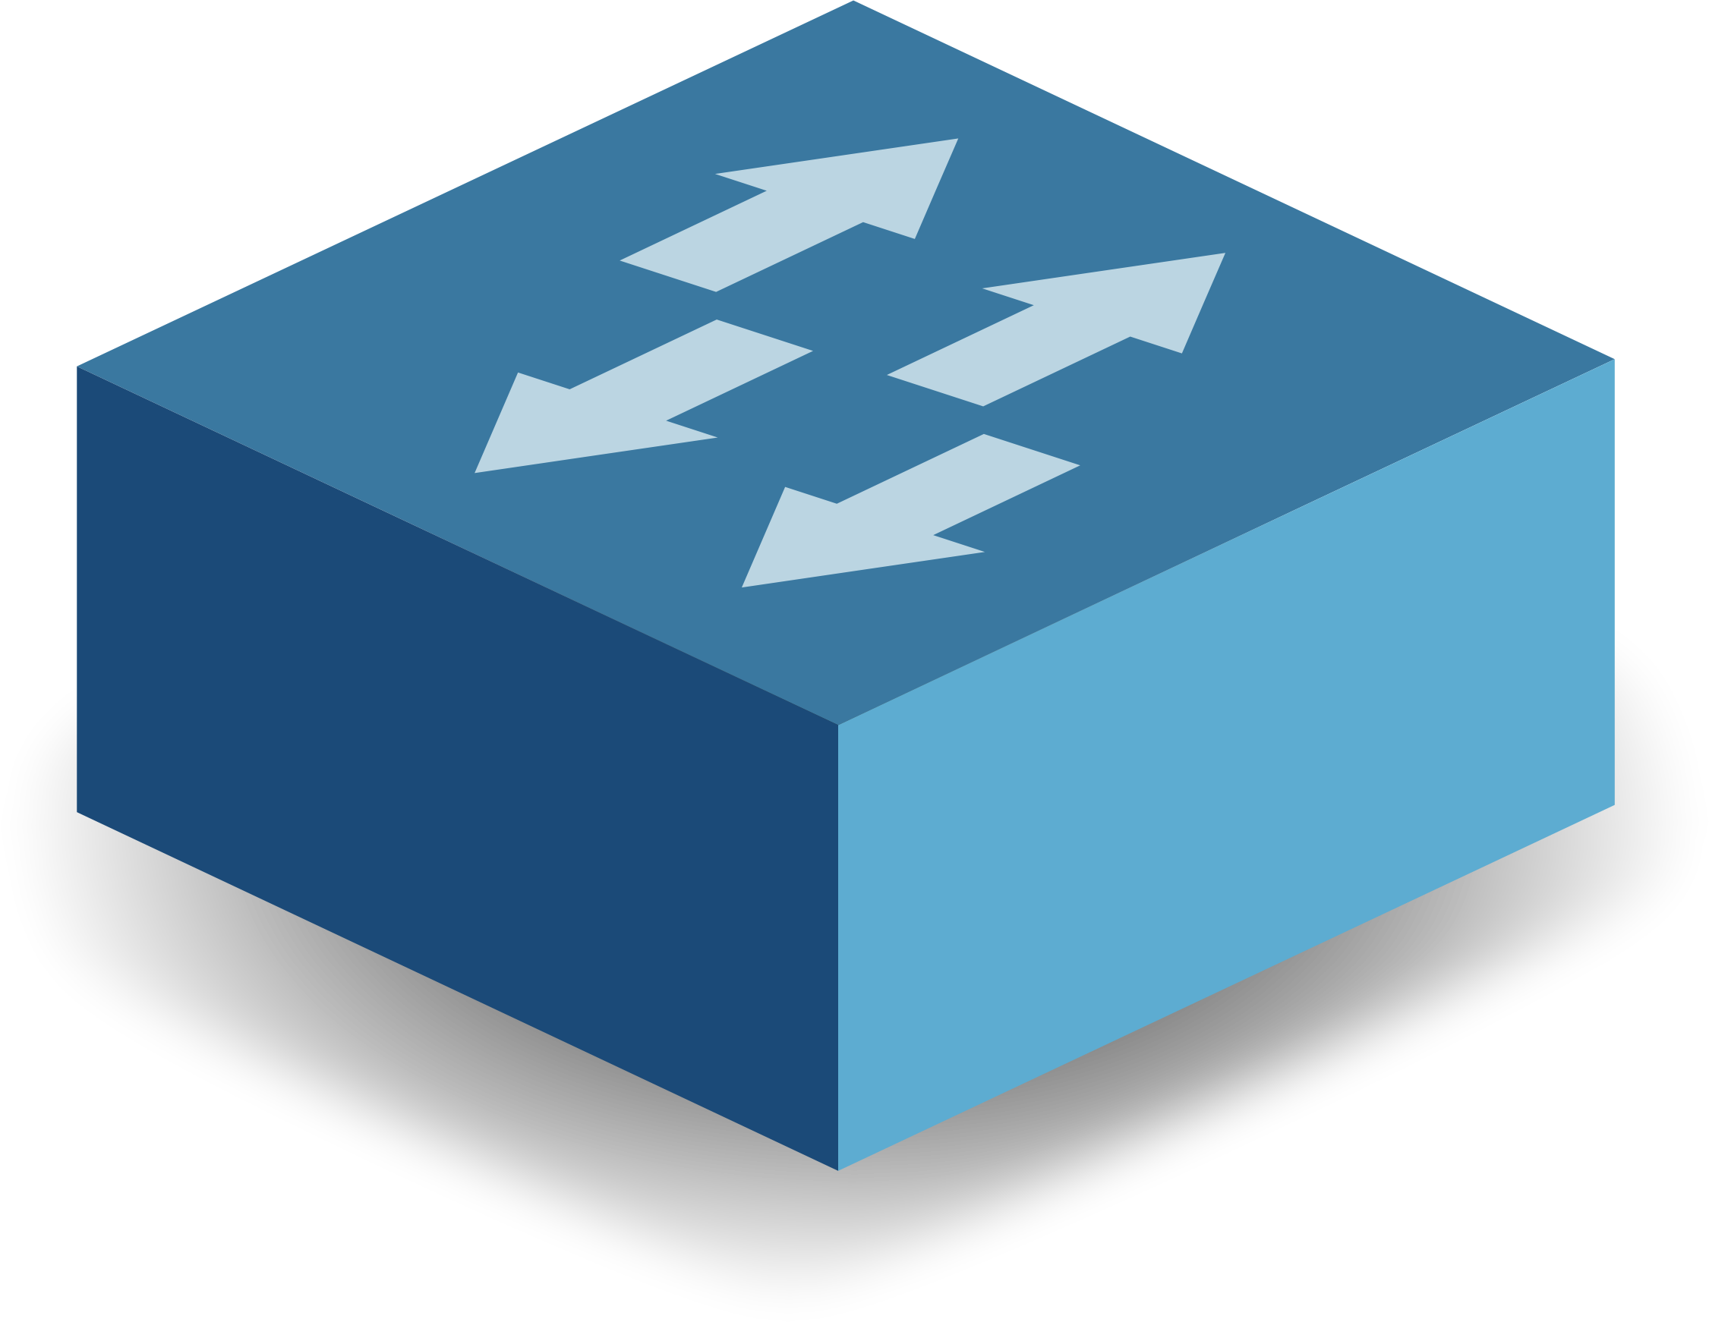
Network Virtualization
Virtual Network 1
Virtual Network 2
Virtual Network 3
Virtualization Layer
VLAN
L2VPN
VxLAN
Hypervisors (SDN)
Physical Network

Slide 5
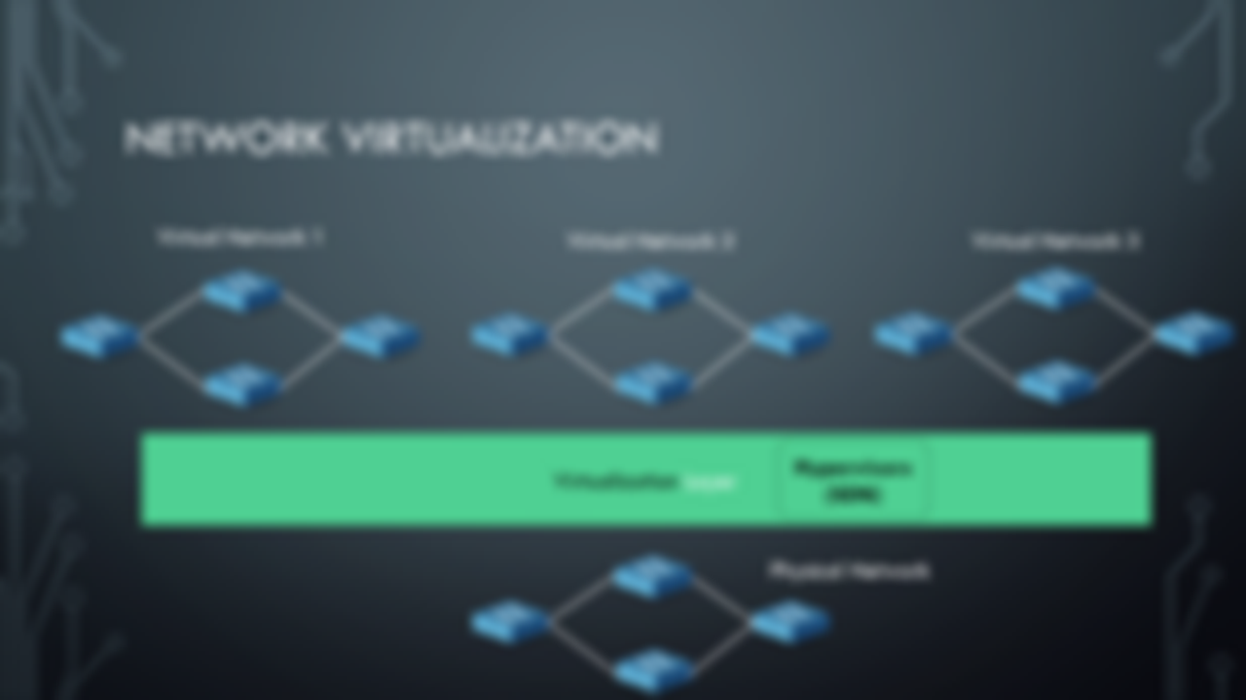

VLAN
L2VPN
VxLAN

Slide 6
Network Virtualization (Overlays/VXLANs)
VMs
VMs
VMs
VMs
OVS (Vmware)
OVS (Vmware)
OVS (VMware)
OVS (VMware)
VxLAN Encapsulation
1) Implement Load-Balancing schemes at the core
2) Cannot support various topologies for tenants
3) Provides Software Switches which fail to give
line-rate traffic.
Network Virtualization in Multi-tenant Datacenters, NSDI 2014

Slide 7
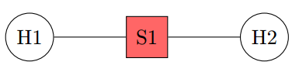
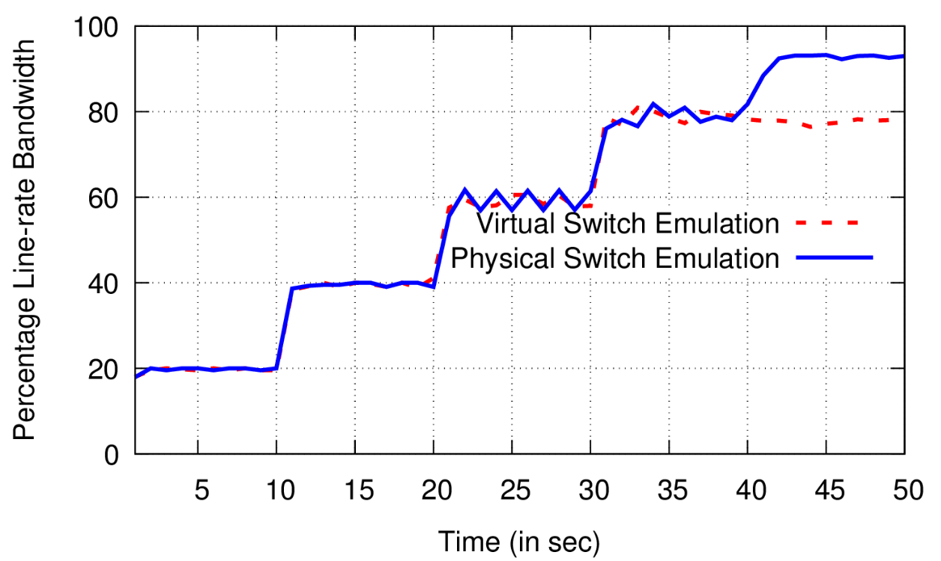
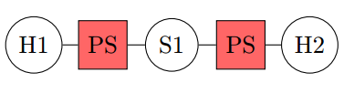
Virtual Switch Emulation
Measuring Throughput
Virtual Topology
Physical Topology

Slide 8
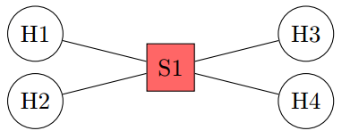
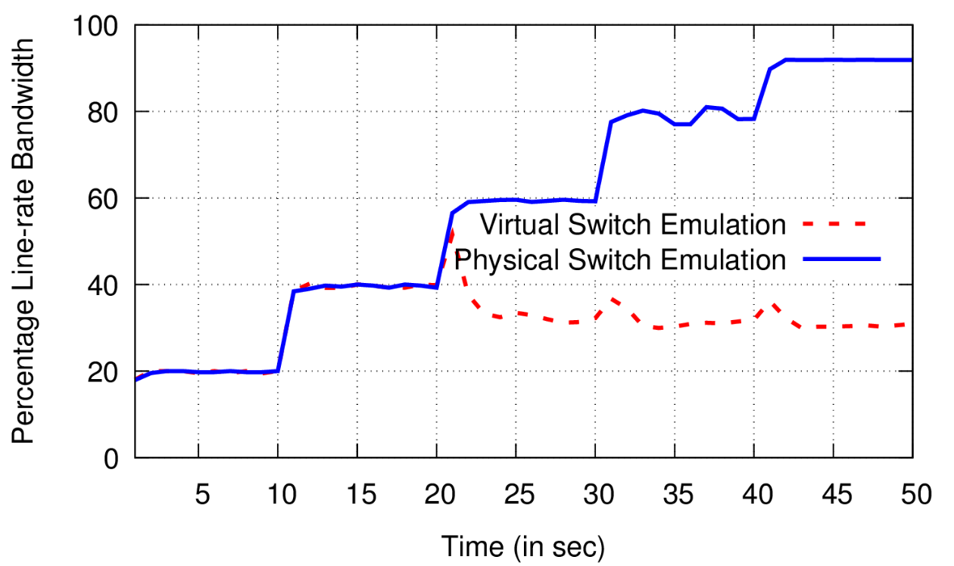
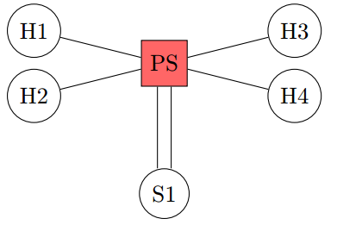
Virtual Switch Emulation
Measuring Throughput

Slide 9
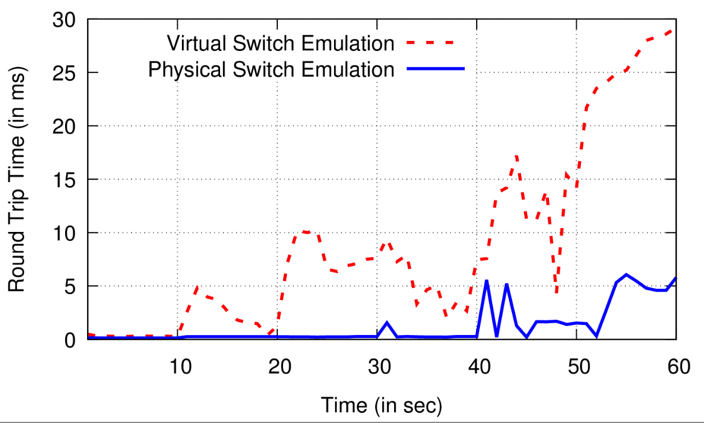
Virtual Switch Emulation
Measuring RTT Variance
Virtual Topology
Physical Topology

Slide 10
Network Virtualization
Virtual Network 1
Virtual Network 2
Virtual Network 3
Virtualization Layer
VLAN
L2VPN
VxLAN
Hypervisors (SDN)
Physical Network

Slide 11
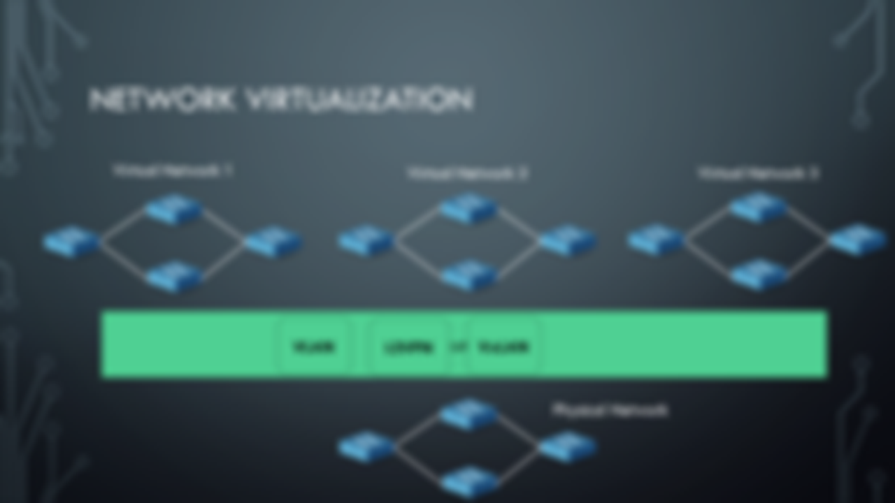
Hypervisors (SDN)

Slide 12


Tenant 1
Tenant 2
Tenant 3
OpenDaylight Controller
ONOS Controller
POX Controller
OpenFlow
Existing Network Hypervisors
OpenFlow
Switch1
Switch2

Slide 13
Tenant 1 (DC)
Tenant 2 (Internet)
Tenant 3 (SDN WAN)
POX Controller
OpenDaylight Controller
ONOS Controller
OpenFlow
Bare-metal Topology Abstraction using existing physical infrastructure
OpenFlow
Switch1
Switch2

Slide 14

Tenant 1 (DC)
Tenant 2 (Random)
Tenant 3 (WAN)
POX Controller
OpenDaylight Controller
ONOS Controller
Virtual Topology
BNV
Switch Abstraction
Network Mapper
Tenant Mapping
Flow Translation
Switch1
Switch2

Slide 15
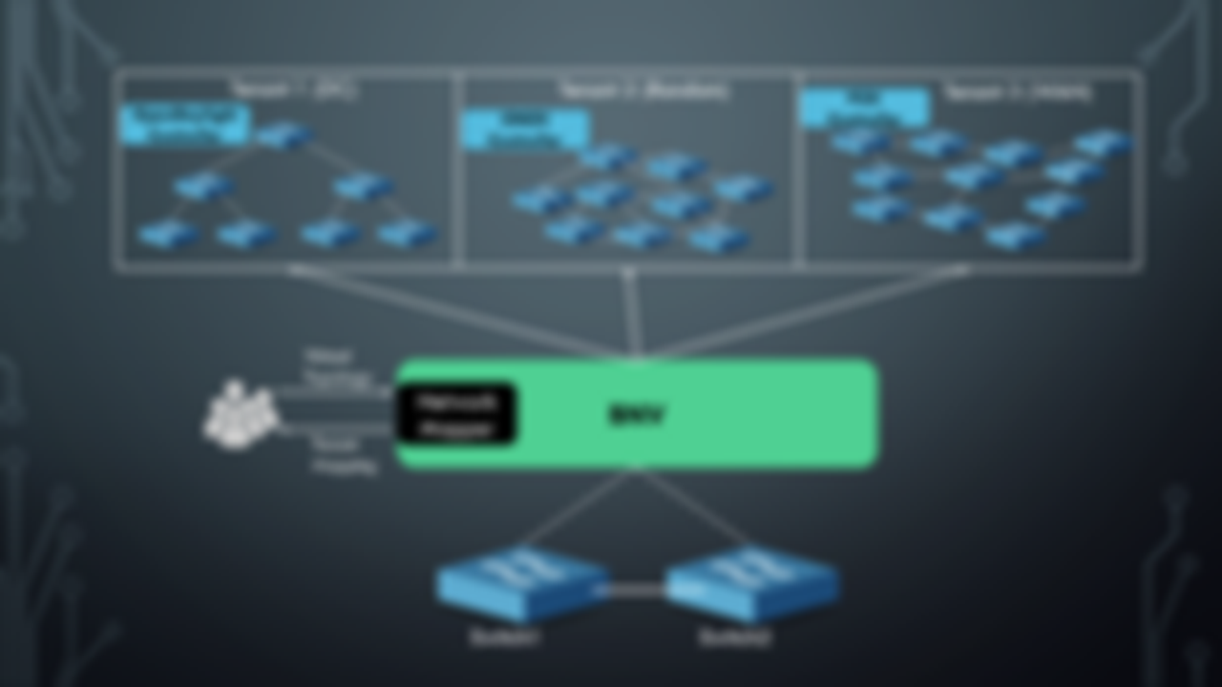
Switch Abstraction
Flow Translation

Slide 16
GENERIC Topology
pSwitch1
CLink1
pSwitch2
5
5
1
2
3
4
1
2
3
4
H1
H2
H3
H4
H5
H6
H7
H8

Slide 17
H1
vS1
vS3
H5
1
2
3
2
1
3
vS2
2
1
3
H2
Virtual Topology
Physical Topology
pSwitch1
CLink1
pSwitch2
5
5
1
2
3
4
1
2
3
4
H1
H2
H3
H4
H5
H6
H7
H8

Slide 18
H1
vS1
vS3
H5
1
2
3
2
1
3
vS2
2
1
3
H2
Virtual Topology
Physical Topology
pSwitch1
CLink1
pSwitch2
5
5
1
2
3
4
1
2
3
4
H1
H2
H3
H4
H5
H6
H7
H8

Slide 19
H1
vS1
vS3
H5
1
2
3
2
1
3
vS2
2
1
3
H2
Virtual Topology
Physical Topology
pSwitch1
CLink1
pSwitch2
5
5
1
2
3
4
1
2
3
4
H1
H2
H3
H4
H5
H6
H7
H8

Slide 20
H1
vS1
vS3
H5
1
2
3
2
1
3
vS2
2
1
3
H2
Virtual Topology
Physical Topology
pSwitch1
CLink1
pSwitch2
5
5
1
2
3
4
1
2
3
4
H1
H2
H3
H4
H5
H6
H7
H8

Slide 21
H1
vS1
CLink1
vS3
H5
1
2
3
2
1
3
vS2
2
1
3
H2
Virtual Topology
Physical Topology
pSwitch1
5
CLink1
pSwitch2
5
1
2
3
4
1
2
3
4
H1
H2
H3
H4
H5
H6
H7
H8

Slide 22
H1
vS1
CLink1
vS3
H5
1
2
3
2
1
3
CLink1
vS2
2
1
3
H2
Virtual Topology
Physical Topology
pSwitch1
5
CLink1
pSwitch2
5
1
2
3
4
1
2
3
4
H1
H2
H3
H4
H5
H6
H7
H8

Slide 23
H1
vS1
CLink1
vS3
H5
1
2
3
2
1
3
CLink1
CLink1
vS2
2
1
3
H2
Virtual Topology
Physical Topology
pSwitch1
5
CLink1
pSwitch2
5
5
5
1
2
3
4
1
2
3
4
H1
H2
H3
H4
H5
H6
H7
H8

Slide 24
Final Mapping
H1
vS1
CLink1
vS3
H5
1
2
3
2
1
3
CLink1
CLink1
vS2
2
1
3
H2
Virtual Topology
Physical Topology
pSwitch1
CLink1
pSwitch2
5
5
1
2
3
4
1
2
3
4
H1
H2
H3
H4
H5
H6
H7
H8

Slide 25
Link 1 using Packet Tagging
PKT
H1
vS1
Link 1 : Tag 1
vS3
H5
1
2
3
2
1
3
Tag 3
Tag 2
vS2
2
1
3
H2
Virtual Topology
Physical Topology
pSwitch1
PKT
1
PKT
pSwitch2
5
CLink1
5
1
2
3
4
1
2
3
4
PKT
H1
H2
H3
H4
H5
H6
H7
H8

Slide 26
Link 2
H1
vS1
Link 1: Tag 1
vS3
H5
1
2
3
2
1
3
PKT
Tag 3
Link 2: Tag 2
vS2
2
1
3
H2
Virtual Topology
Physical Topology
pSwitch1
PKT
CLink1
PKT
2
pSwitch2
5
5
1
2
3
4
1
2
3
4
H1
H2
H3
H4
PKT
H5
H6
H7
H8

Slide 27
Link3 :
Bounce back Link
H1
vS1
Link 1 : Tag 1
vS3
H5
1
2
3
2
1
3
Link 3: Tag 3
Link 2: Tag 2
vS2
2
1
3
H2
Virtual Topology
PKT
Physical Topology
Overhead = 100%
PKT
3
pSwitch1
PKT
CLink1
pSwitch2
5
5
1
2
3
4
1
2
3
4
H1
H2
H3
H4
H5
H6
H7
H8
PKT

Slide 28
Can we do better?

Slide 29
Topology + Loopback link
pSwitch1
CLink1
pSwitch2
5
5
1
2
3
4
1
2
3
4
H1
H2
LoopLink1
H5
H6
LoopLink2

Slide 30
H1
vS1
CLink1
vS3
H5
1
2
3
2
1
3
vS2
2
1
3
H2
Virtual Topology
Physical Topology
pSwitch1
CLink1
pSwitch2
5
5
1
2
3
4
1
2
3
4
H1
H2
LoopLink1
H5
H6
LoopLink2

Slide 31
H1
vS1
CLink1
vS3
H5
1
2
3
2
1
3
CLink1
vS2
2
1
3
H2
Virtual Topology
Physical Topology
pSwitch1
5
CLink1
pSwitch2
5
1
2
3
4
1
2
3
4
H1
H2
LoopLink1
H5
H6
LoopLink2

Slide 32
H1
vS1
CLink1
vS3
H5
1
2
3
2
1
3
LoopLink1
CLink1
vS2
2
1
3
H2
Virtual Topology
Physical Topology
pSwitch1
5
CLink1
pSwitch2
5
1
2
3
4
1
2
3
4
H1
H2
LoopLink1
H5
H6
LoopLink2

Slide 33
Link3 :
Loop Link
H1
vS1
Link 1 : Tag 1
vS3
H5
1
2
3
2
1
3
Link 2: Tag 2
Link 3: Tag 3
No Traffic Overhead in Core Link.
vS2
2) Consistency & Fidelity of mapping.
2
3
3) Complete traffic isolation.
1
H2
Virtual Topology
PKT
Physical Topology
pSwitch1
CLink1
pSwitch2
5
5
1
2
3
4
1
2
3
4
H1
H2
LoopLink1
H5
H6
LoopLink2
PKT

Slide 34
Tenant 1 (DC)
Tenant 2 (Random)
Tenant 3 (WAN)
Virtual Topology
BNV
Switch Abstraction
Network Mapper
Tenant Mapping
Flow Translation
Switch1
Switch2

Slide 35
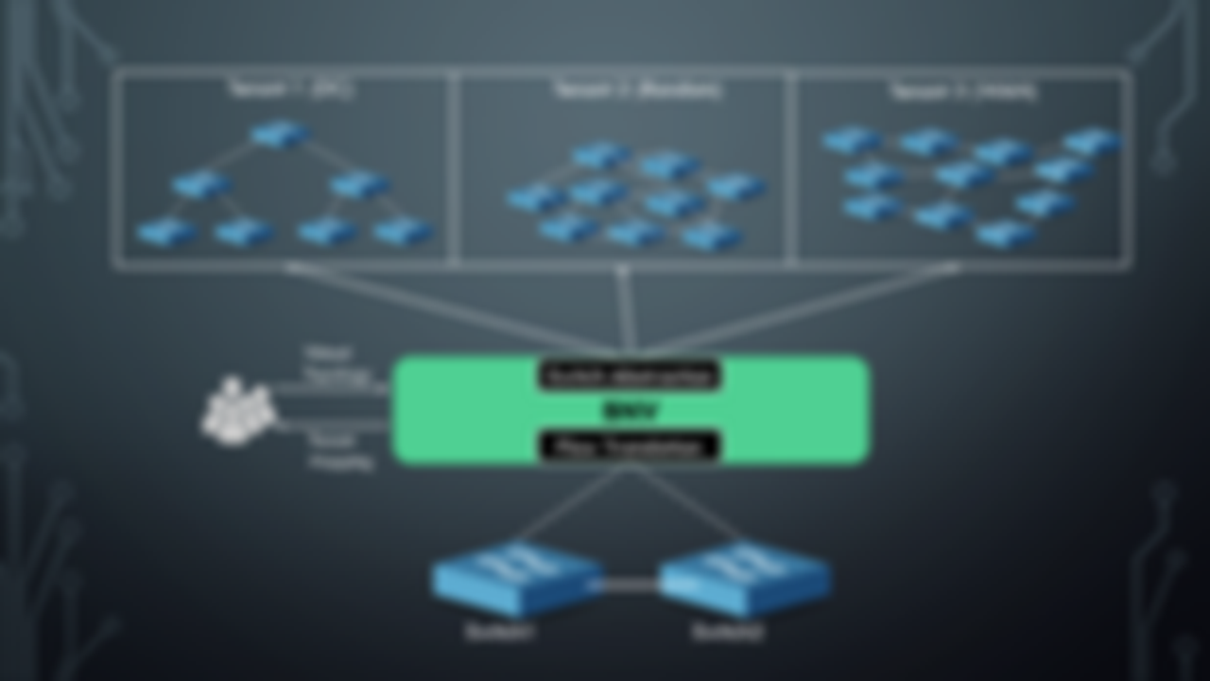
Network Mapper

Slide 36
Network Mapper/Embedder
Request
Network Mapper
Mapping

Slide 37
Network Mapper
Request
1
1
Network Mapper
10
1
1
1
1
Mapping

Slide 38
Network Mapper
C=x7
Request
1
1
Network Mapper
10
C=x5
C=x6
1
1
1
1
Mapping
C=y1
C=y2
C=x1
C=x2
C=x3
C=x4

Slide 39


Network Mapper – Key Ideas
1) Network mapping is done considering mapping of switch-ports instead of switches.
H1
H2
H3
H4
Switch
Switch
1
2
3
4
S1
S2
S3
S4
Switch
$$X_{ρ,q}=\left\{\begin{aligned}1 ;if ρ is placed in q \\ 0 ;otherwise \end{aligned}\right.$$
Switch-ports :
$$Y_{ρ,q}=\left\{\begin{aligned}1 ;if ρ is placed in q \\ 0 ;otherwise \end{aligned}\right.$$
Hosts :

Slide 40

Network Mapper – Key Ideas
2) Objective is to Minimize the usage of Core-links:
a) Maximizes isolation to the tenant, keeping links dedicated.
b) Provides scope for dynamic expansions. (Adding/upgrading tenants)
$$min : \sum_{\left\{q1,q2\right\}∈T}{\sum_{\{e1,e2\}∈Lc}{Xe1,q1 . Xe2,q2 . b(e1,e2)}}$$

Slide 41



Network Mapper – Constraints
$$∀i∈P: \sum_{j ∈Q}{Xi,j=1}$$
1) Switch one-to-one mapping
$$∀i∈V: \sum_{j ∈H}{Yi,j=1}$$
2) Host one-to-one mapping
$$∀\{i,j\}∈Lc: \sum_{\left\{k,h\right\}∈Kc}{Xi,k.Xj,h=1}$$
3) Link one-to-one mapping

Slide 42
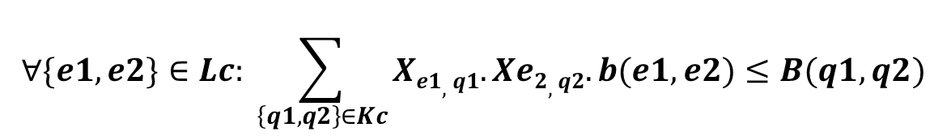


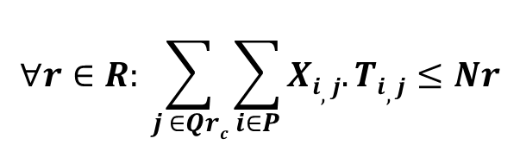
Network Mapper – Constraints
$$∀\left\{i,j\right\}∈Lh: \sum_{j ∈H}{Xi,q1. Xj,h1. δ(q1,h1)=1}$$
4) Switch-Host connectivity constraint
$${δ(q1,h1)}_{}=\left\{\begin{aligned} 1 ;\text{if} \text{host} \text{h}\text{1 }\text{is} \text{connected} \text{to} \text{switch}\text{−}\text{port} \text{q}\text{1} \\ 0 ;otherwise \end{aligned}\right.$$
$$∀\{e1,e2\}∈Lc: \sum_{\left\{q1,q2\right\}∈Kc}{Xe1,q1.Xe2,q2.b(e1,e2)≤B(q1,q2)}$$
5) Link Bandwidth constraint
$$∀r∈R: \sum_{j ∈Qrc}{\sum_{i∈P}{Xi,j.Ti,j≤Nr}}$$
6) TCAM capacity constraint

Slide 43
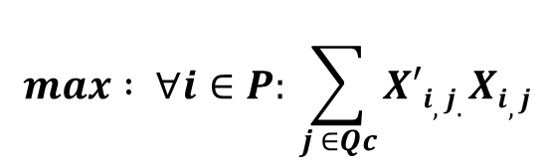
Network Mapper – Updates
Spec update of an existing tenant :
Minimize impact to other/current tenant(s)
$$max : ∀i∈P: \sum_{j ∈Qc}{X′i,j.Xi,j}$$

Slide 44



Implementation
Implemented on top of
Integrated with a Bare-metal provisioning service (Testbed).
Deployed on NCL Staging environment.
TODO: Deploy Production environment
Details :
Use of ToS-bit in IP for Ltag.
Support OpenFlow 1.0, TODO: Upgrade to OpenFlow 1.3
Gurobi Solver for ILP.

Slide 45
evaluation
Testbed Experiments
Simulation of Network Mapper

Slide 46
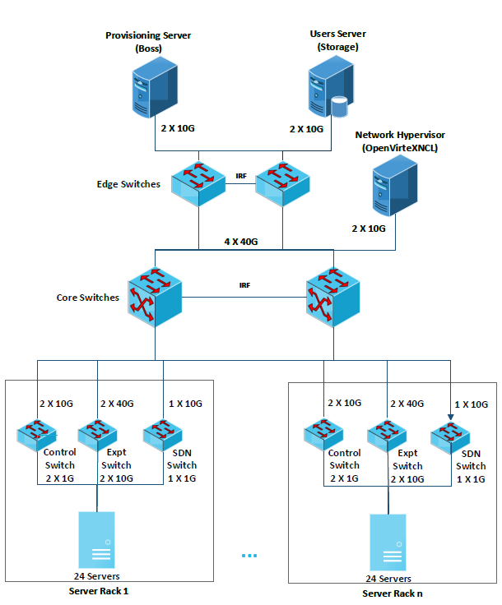
evaluation – Testbed Experiments

Slide 47
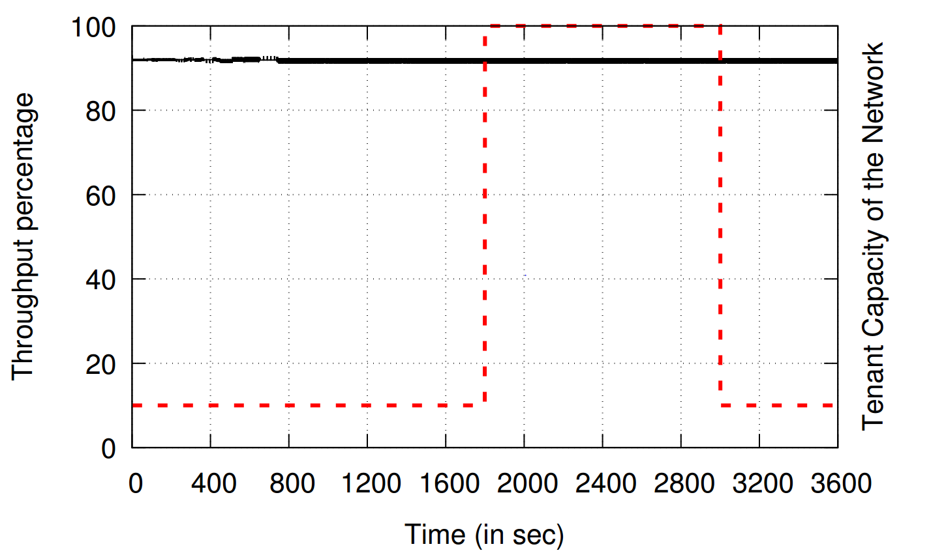
evaluation – Testbed Experiments
All Tenants
1 Tenant

Slide 48
Evaluation- Simulation of Network Mapper
Core L2 Switch
SDN
Switch1
SDN
Switch2
SDN
Switch3
SDN
Switch4
SDN
Switch5
12
Loops
12
Loops
12
Loops
12
Loops
12
Loops
24
Servers
24
Servers
24
Servers
24
Servers
24
Servers

Slide 49
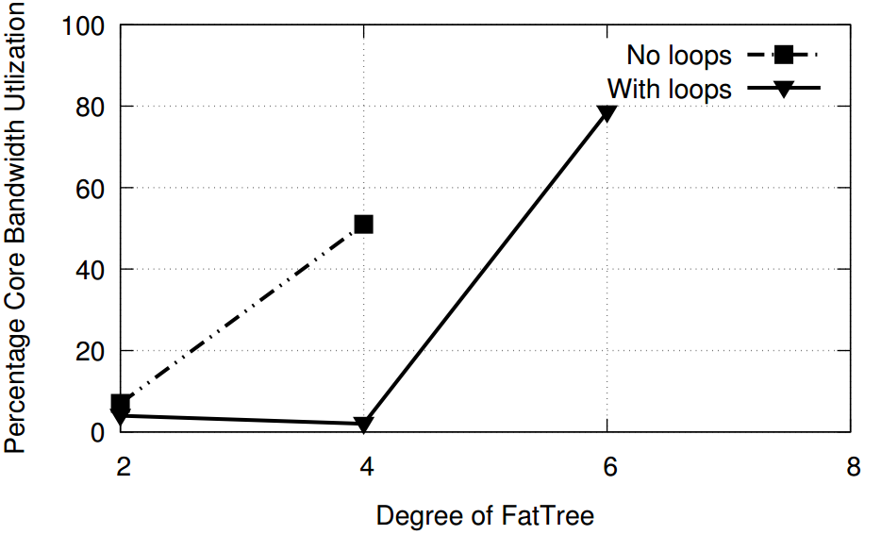
Evaluation- Simulation of Network Mapper
Fat-Tree Topologies

Slide 50
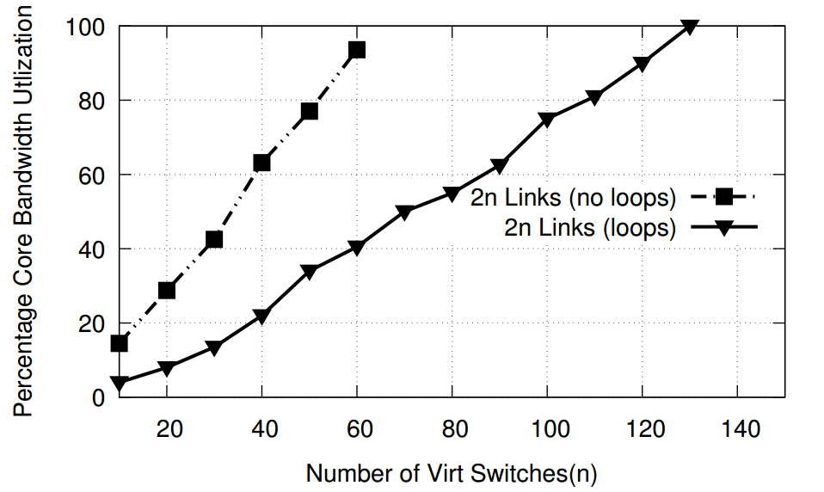
Evaluation- Simulation of Network Mapper
Random Topologies : 2n links
~2 x Gain

Slide 51
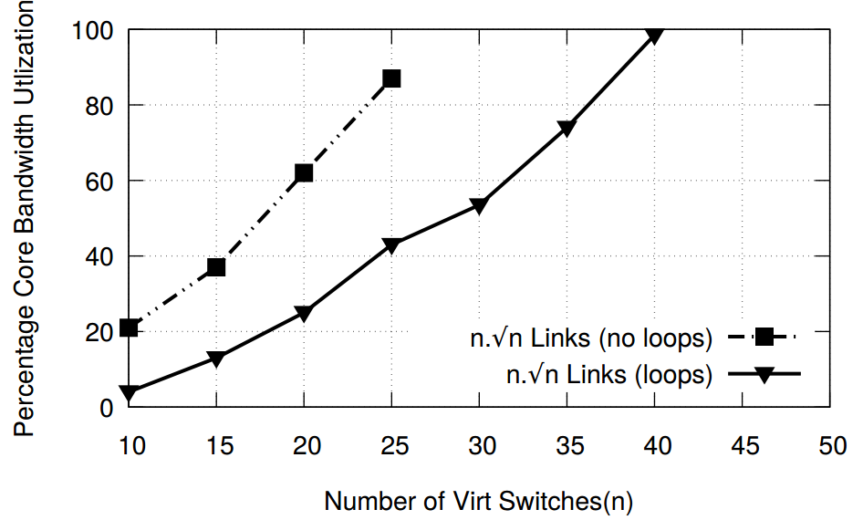
Evaluation- Simulation of Network Mapper
Random Topologies : 2n links

Slide 52
Conclusion
Network Virtualization with hardware (bare-metal) switches :
flexibility of software + fidelity of hardware
Useful to emulate large DCs, ISPs within cloud.

Slide 54
